Slide 1
23
Game
Programming
with OGRE

Slide 2
Come, Watson, come! The game is afoot.
  Sir Arthur Conan Doyle
For it’s one, two, three strikes
you’re out at the old ball game.
  Jack Norworth
The game is up.
  William Shakespeare

Slide 3
If you wish to avoid foreign collision,
you had better abandon the ocean.
  Henry Clay
There is strong shadow where
there is much light.
  Johann Wolfgang von Goethe
Wagner’s music is better than it sounds.
  Mark Twain

Slide 4
OBJECTIVES
In this chapter you’ll learn:
Some basics of game programming.
Where to find instructions on how to install
the Ogre 3D graphics engine to work with
your C++ programs on the Windows,
Linux and Mac platforms.
To create games using Ogre.
To perform collision detection.
To use Ogre to import and display graphics.

Slide 5
OBJECTIVES
To use OgreAL to integrate the OpenAL audio library into your games.
To have Ogre accept keyboard input.
To create the simple game Pong® with Ogre and OgreAL.
To use Ogre to regulate the speed of a game.

Slide 6
23.1 Introduction
23.2 Installing Ogre, OgreAL and OpenAL
23.3 Basics of Game Programming
23.4 The Game of Pong: Code Walkthrough
23.4.1 Ogre Initialization
23.4.2 Creating a Scene
23.4.3 Adding to the Scene
23.4.4 Animation and Timers
23.4.5 User Input
23.4.6 Collision Detection
23.4.7 Sound
23.4.9 Pong Drive
23.5 Wrap-Up
23.6 Ogre Internet and Web Resources

Slide 7
23.2 Installing Ogre, OgreAL and OpenAL
Ogre 1.4 (Eihort)
  SDK
  Source code
  www.ogre3d.org
OgreAL for Ogre 1.4
  OpenAL
  Ogg
  Vorbis
  www.deitel.com/books/cpphtp6

Slide 8
23.3 Basics of Game Programming
Graphics
  Ogre (Object-oriented Graphics Rendering Engine)
    Hides the tedious and complex graphics API code
  Cross-platoform
    Windows, Linux and Mac
3D Models
  Computer representation of an object which can be drawn on the screen

Slide 9
23.3 Basics of Game Programming (Cont.)
Materials
  Control an object’s appearance
    Colors are determined by red, green and blue light intensities ranging from 0 to 1
    Textures are 2D images wrapped around a 3D model
Lighting
  Ambient—general lighting with no apparent source
  Diffuse—specific direction, reflects evenly off all surfaces
  Emissive—emanates from an object
  Specular—reflects relative to position and direction of the viewer; makes objects appear shiny

Slide 10
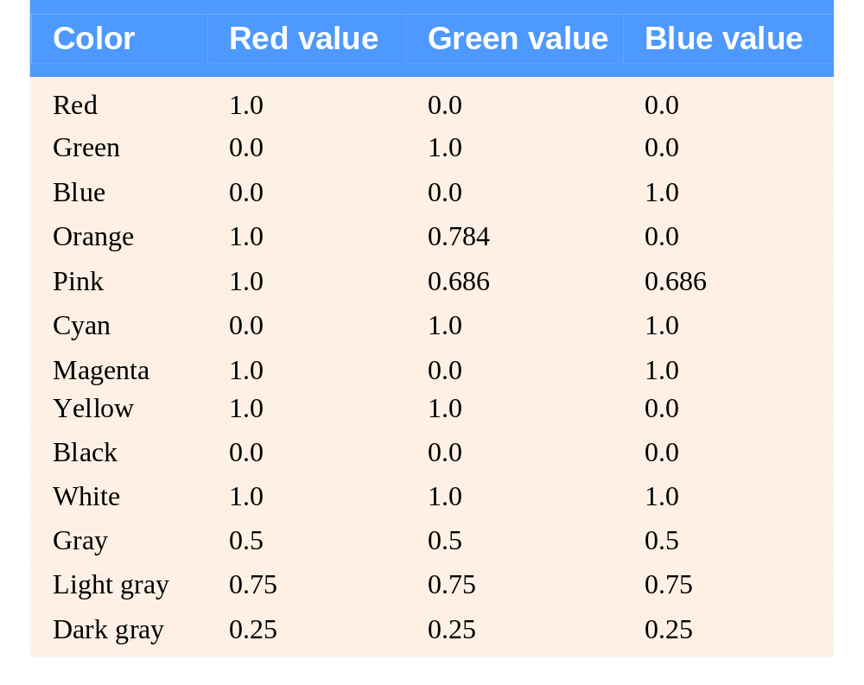
Fig. 23.1 | Red, green, and blue intensities of common
colors in Ogre.

Slide 11
23.3 Basics of Game Programming (Cont.)
Collision Detection and Response
  Determine whether two objects are touching
  React appropriately
  Collision detection and physics libraries ease the process
Sound
  3D sound models sounds coming from different directions and distances
  Audio libraries allow you to add sound to the game

Slide 12
23.3 Basics of Game Programming (Cont.)
Text
  Often used to communicate with the player
Timers
  Control game speed to create a consistent experience on different computers

Slide 13
24 The Game of Pong: Code Walkthrough
Four major game objects
  Ball
  Two paddles
  Rectangular playing field

Slide 14
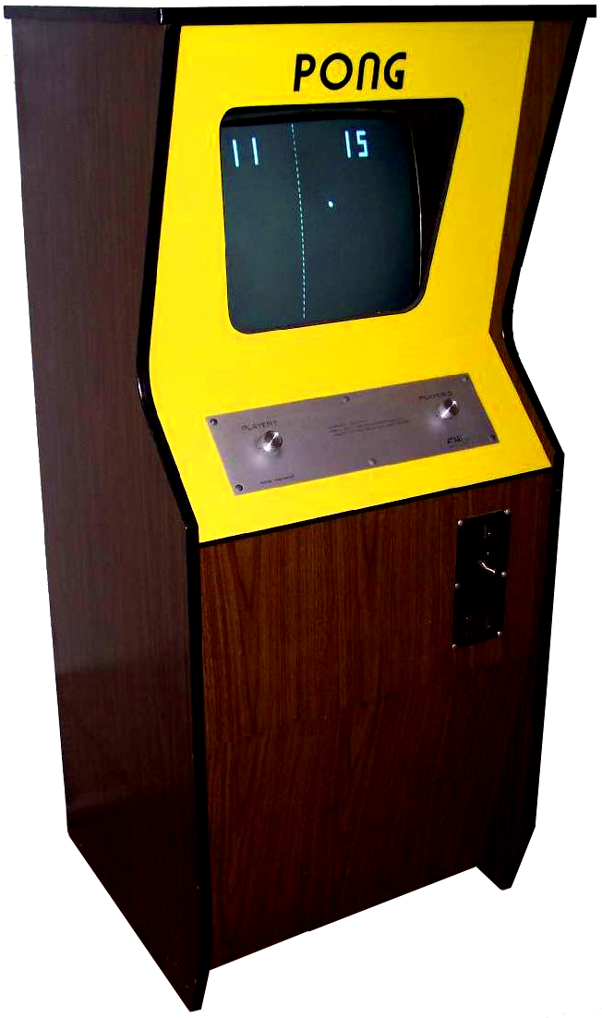
Fig. 23.2 | Atari’s Pong coin-op went into commercial production in November of 1972,
selling a total of 38,000 machines. The game was designed entirely in TTL circuits,
using no CPU or game code software. Its “code” was implemented using simple
“gate” chips, timers and counter chips. This simple, fun and addictive game was the cornerstone of what became the video game industry. (PONG® classic video
game courtesy of Atari Interactive, Inc. © 2007 Atari Interactive, Inc.
All rights reserved. Used with permission.)

Slide 15
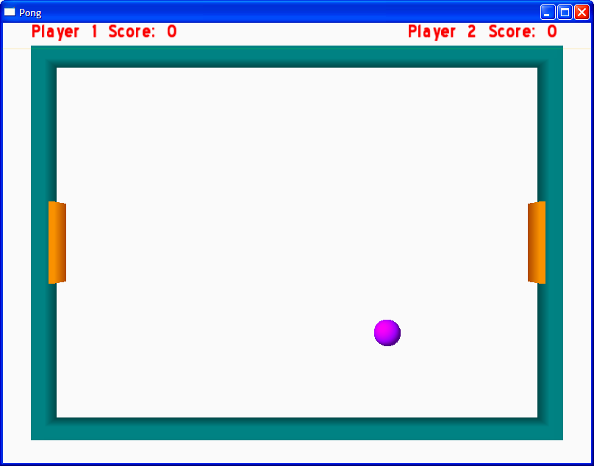
Fig. 23.3 | Pong game objects.

Slide 16
23.4.1 Ogre Initialization
Ogre.h header file includes the most commonly used headers
Root object is used to initialize Ogre
  showConfigDialog function displays the OGRE Engine Rendering Setup dialog box
    Program should end if user cancels the dialog box
  initialise function creates the RenderWindow
RenderWindow is the window in which Ogre renders graphics

Slide 17
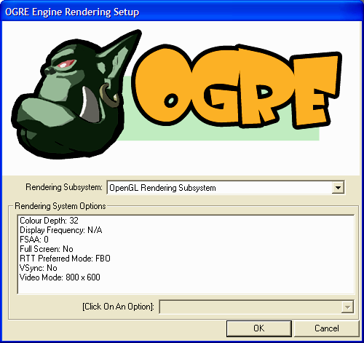
Rendering subsystem
(OpenGL or Direct3D)
Color Depth
Resolution
Fig. 23.6 | OGRE Engine Rendering Setup dialog box.

Slide 18
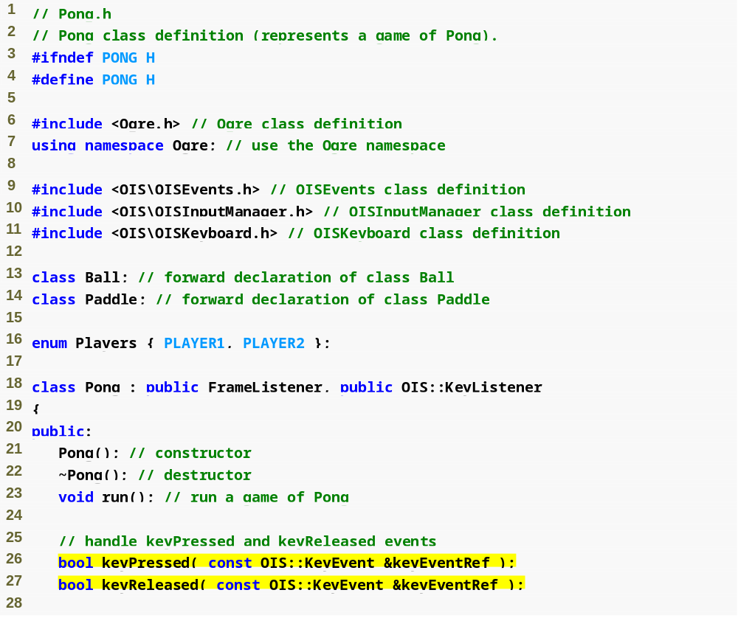
Outline
Include the most common Ogre header files
Pong.h
(1 of 3)
Inherit from FrameListener and KeyListener
KeyListener functions

Slide 19
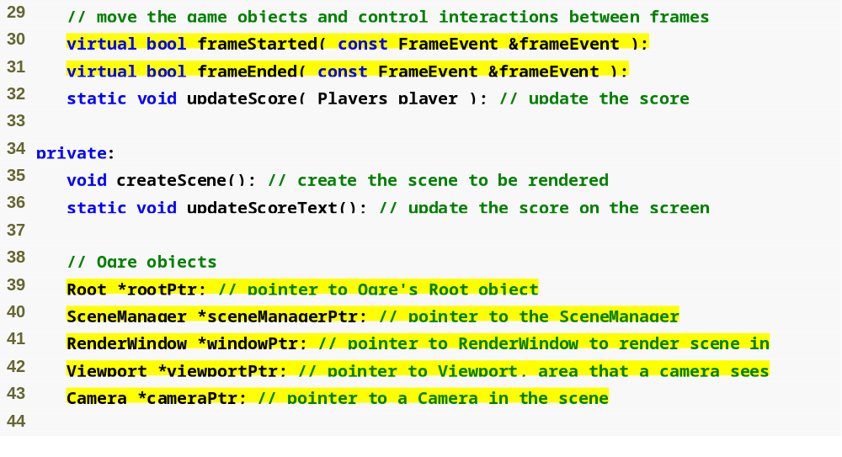
Outline
FrameListener functions
Pong.h
(2 of 3)
Important Ogre objects

Slide 20
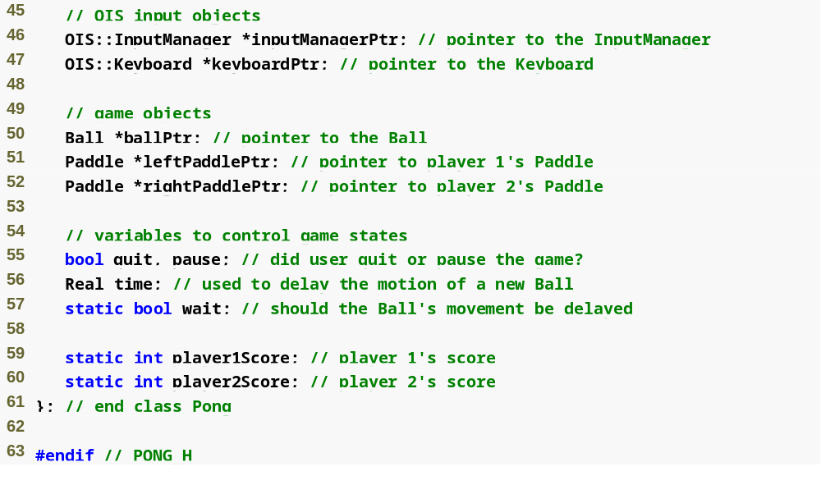
Outline
Important input handling objects (OIS)
Pong.h
(3 of 3)
Control variables
Game objects (ball and paddles)

Slide 21
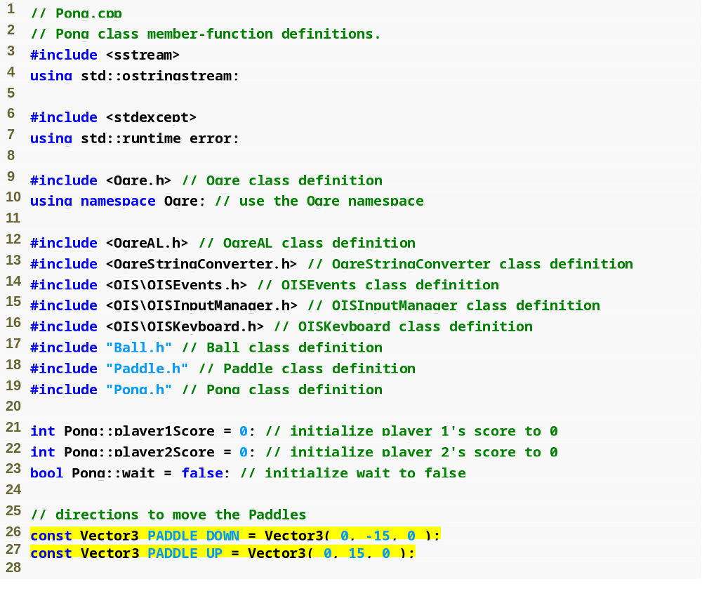
Outline
Pong.cpp
(1 of 12)
Vector3s used to move the Paddles

Slide 22
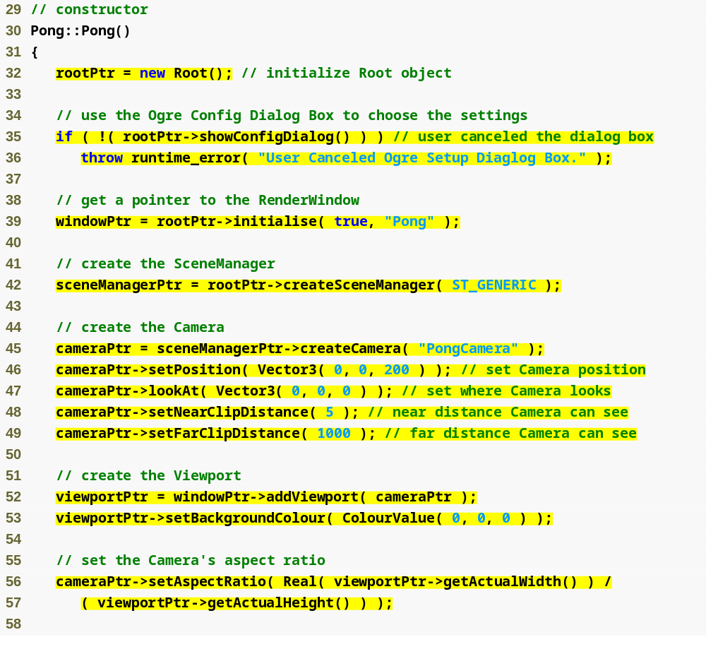
Create the Root object
Outline
Pong.cpp
(2 of 12)
Create the RenderWindow
Use a dialog box to choose render settings, end program if user cancels
Create the SceneManager
Create and configure the Camera
Display the Camera’s content in the RenderWindow

Slide 23
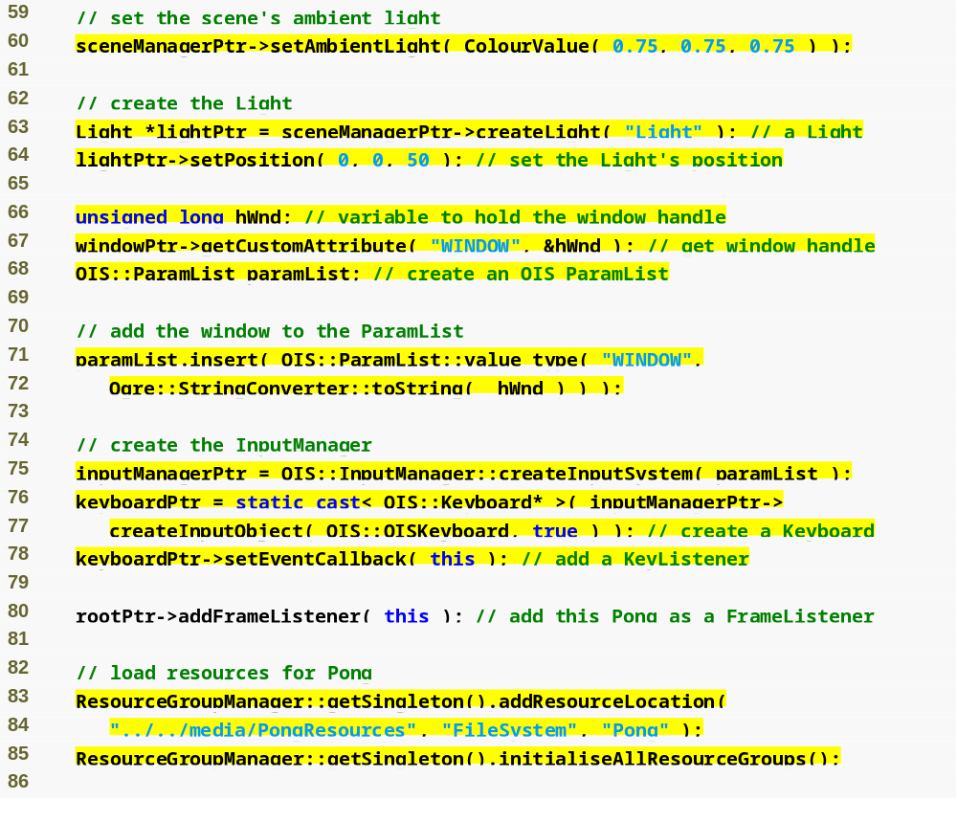
Outline
Pong.cpp
(3 of 12)
Create a Point Light and set its position
Create the InputManager which manages the various input objects
Represent the keyboard as an object
Register this Pong object with Ogre to receive FrameEvent notifications
Register this Pong object with the Keyboard to receive KeyEvent notifications
Load the scripts, meshes and sounds

Slide 24
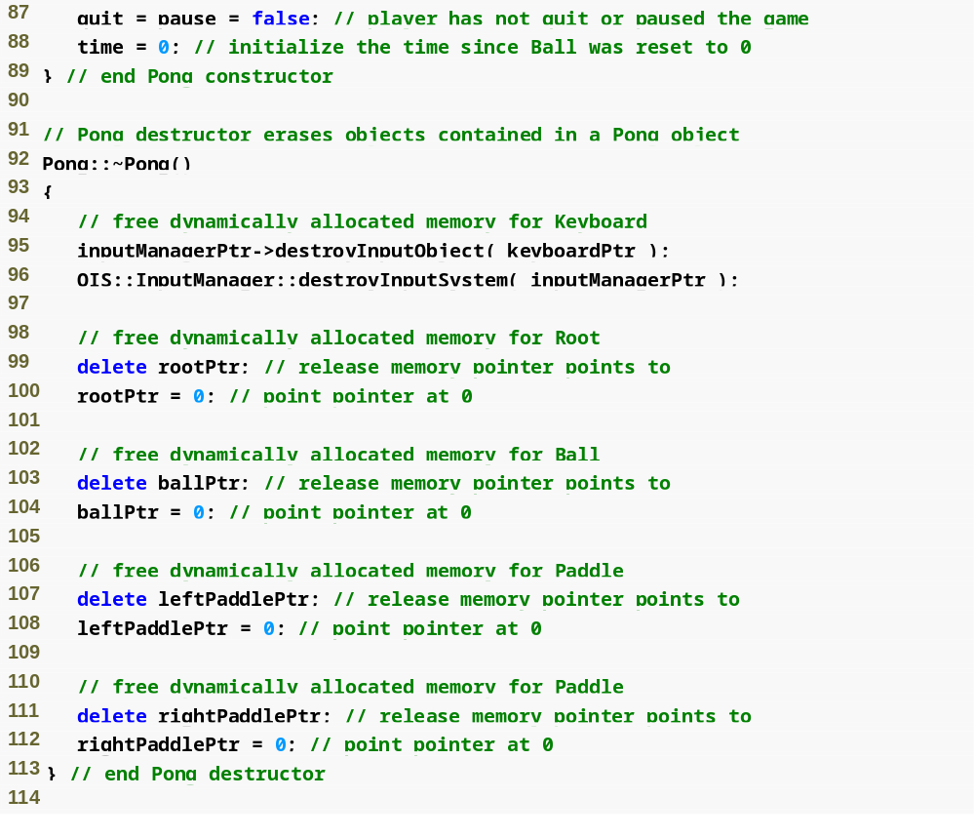
Outline
Pong.cpp
(4 of 12)
Use InputManager functions to destroy OIS objects

Slide 25
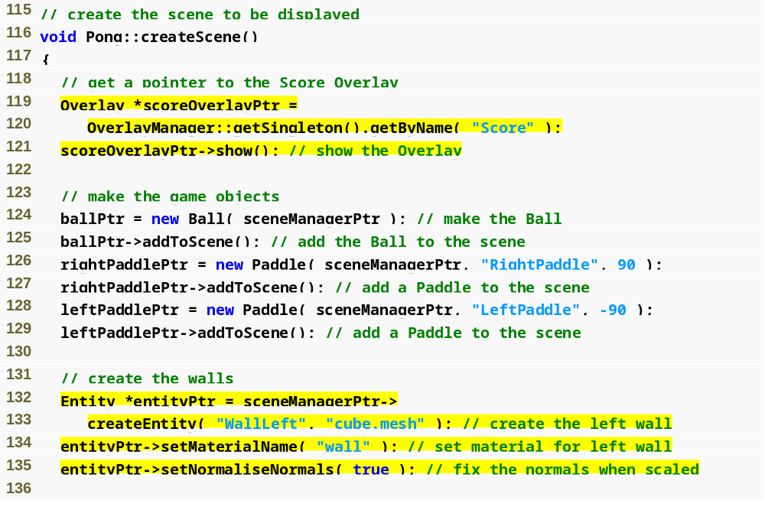
Outline
Pong.cpp
(5 of 12)
Use the OverlayManager to access the Score Overlay and show it on the screen
Add the Ball and the Paddles to the scene
Use the SceneManager to create an Entity representing a wall
Set the material used to color the wall
Recalculate lighting effects whenever the Entity is resized

Slide 26
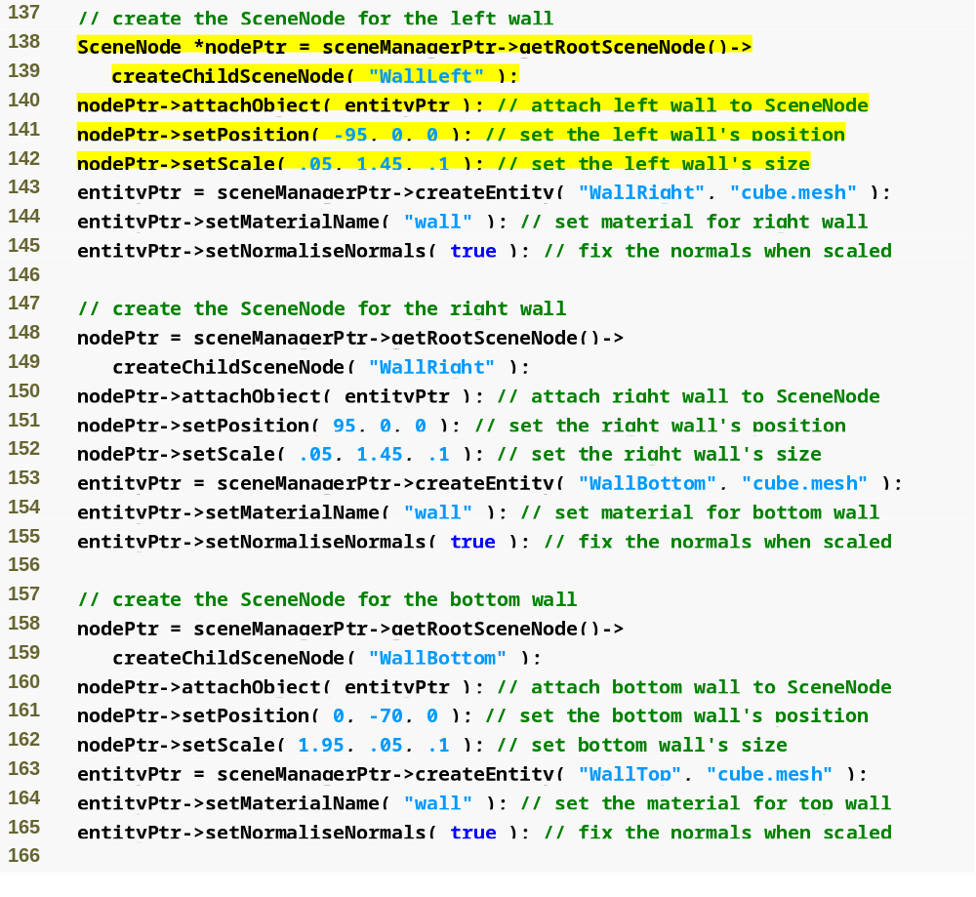
Outline
Create a SceneNode that is a child of the root SceneNode
Retrieve the root SceneNode
Attach the wall Entity to the new SceneNode
Pong.cpp
(6 of 12)
Change the size of the wall relative to its current size
Set the position of the SceneNode

Slide 27
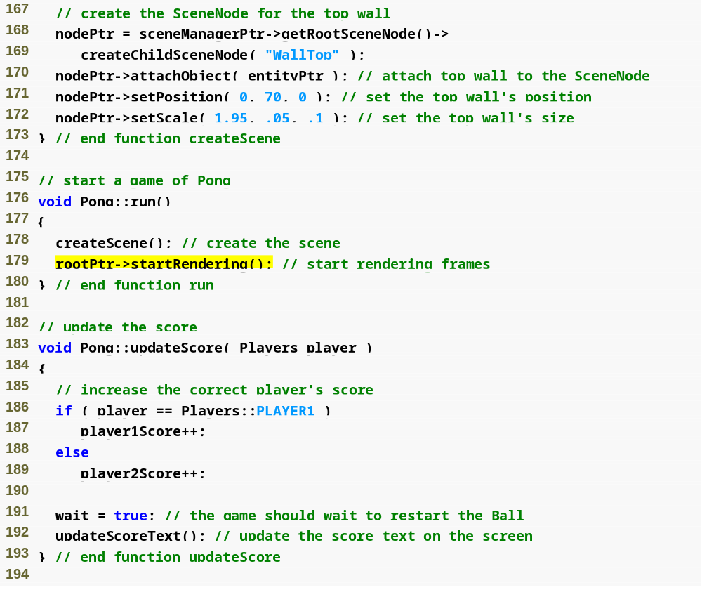
Outline
Pong.cpp
(7 of 12)
Start rendering and continue until frameStarted or frameEnded return false
Set the control variable to pause the Ball’s movement after a player scores

Slide 28
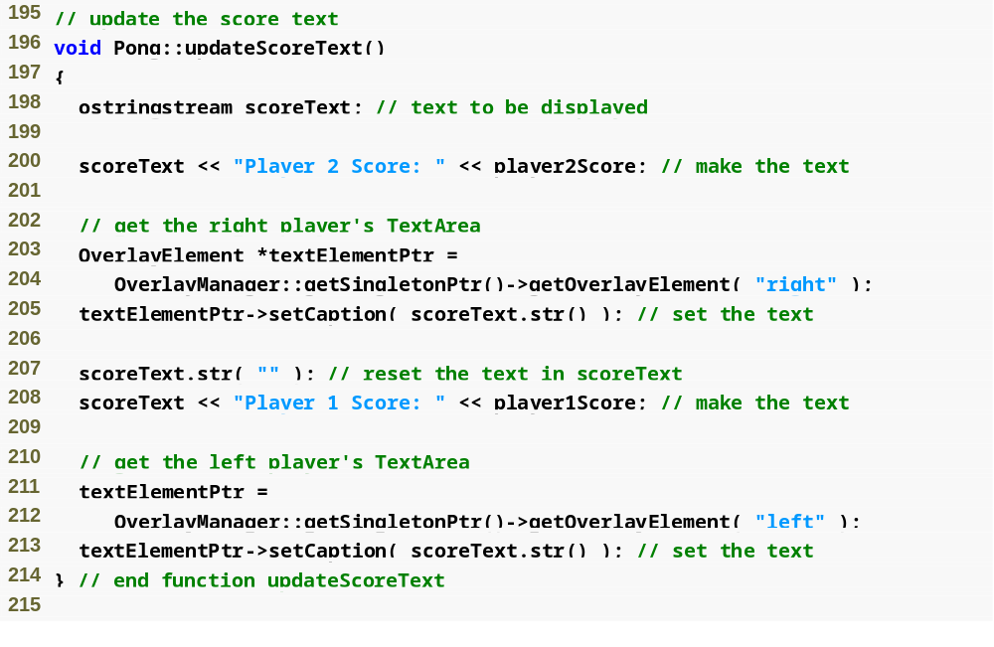
Outline
Use the OverlayManager to access a TextAreaOverlayElement
Pong.cpp
(8 of 12)
Change the text displayed by a TextAreaOverlayElement

Slide 29
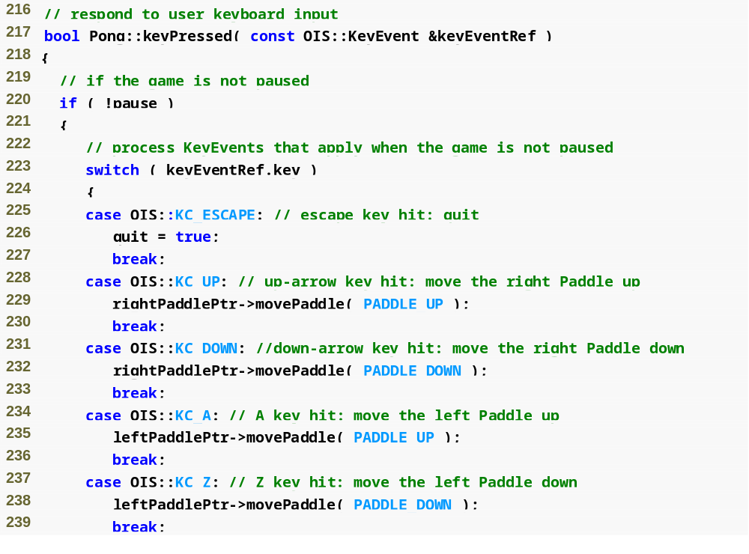
Outline
Get the KeyCode from the KeyEvent
Pong.cpp
(9 of 12)
Move the Paddles based on what key was pressed

Slide 30
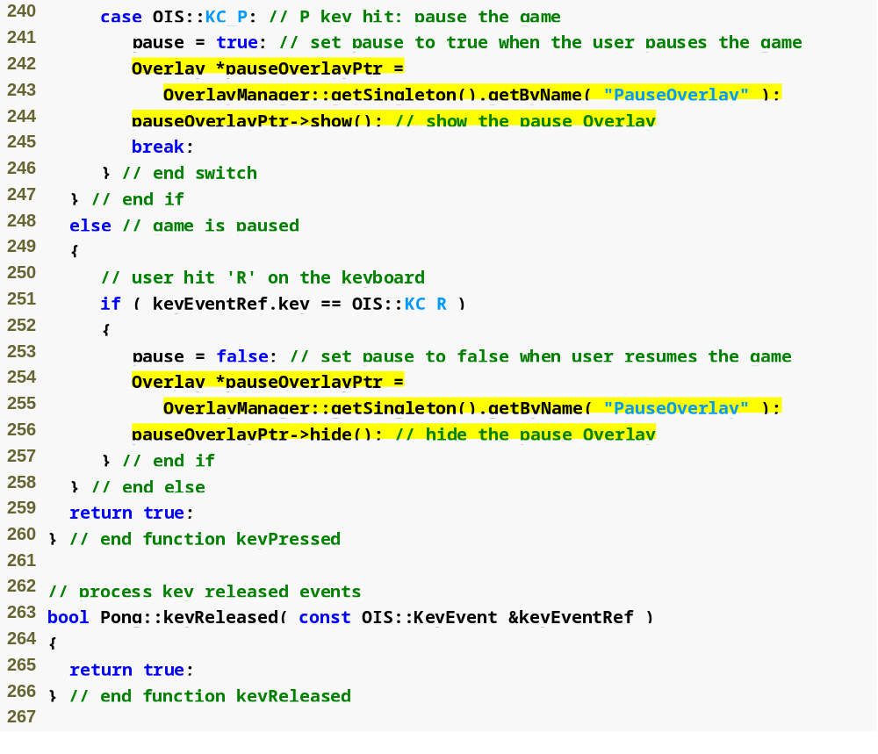
Outline
Pong.cpp
(10 of 12)
Show the PauseOverlay
Pause the game when the user hits P
If the game is paused, only respond to the R key
Hide the PauseOverlay

Slide 31
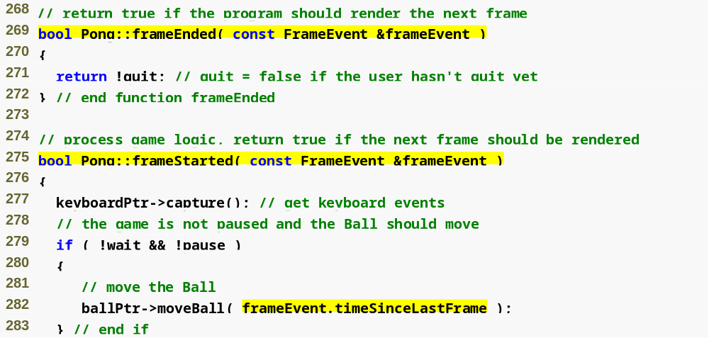
Outline
Called at the beginning of every frame
Called at the end of every frame
Pong.cpp
(11 of 12)
Collect KeyEvents from the keyboard
If the game and Ball aren’t paused, move the Ball
The time, in seconds, since the last frame was rendered

Slide 32
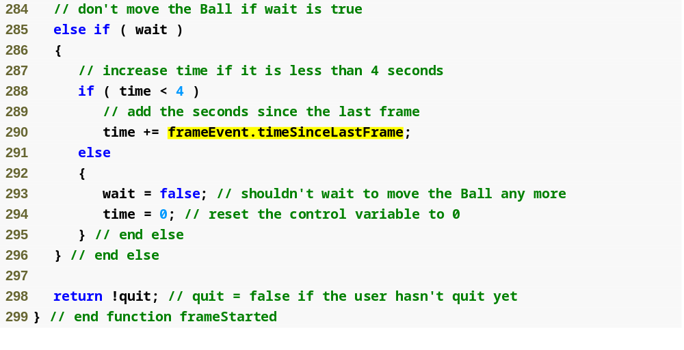
Outline
Wait to move the Ball for four seconds after a player scores
Pong.cpp
(12 of 12)

Slide 33
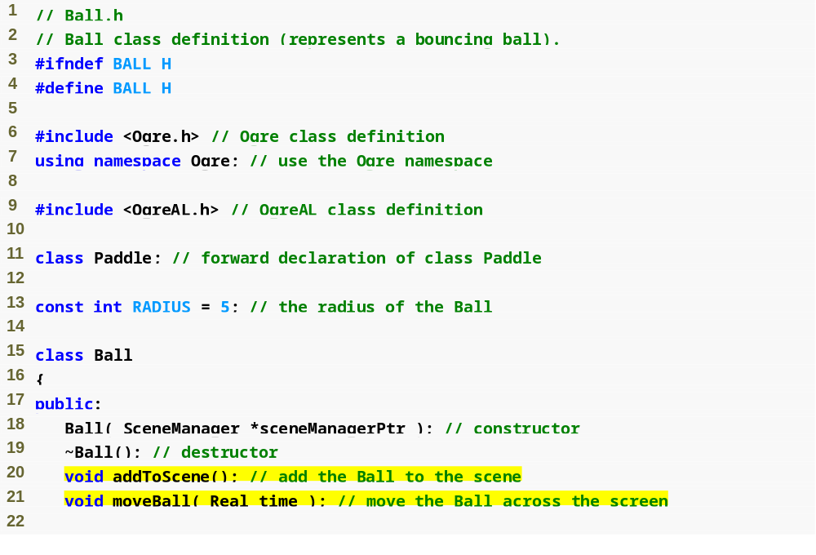
Outline
Ball.h
(1 of 2)
Radius of the Ball
Add the Ball to the scene
Move the Ball based on time

Slide 34
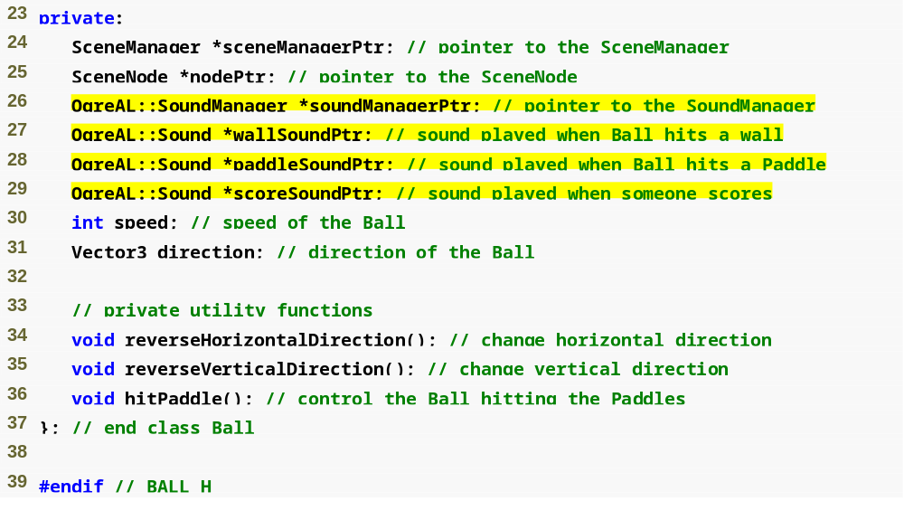
OgreAL object to manage sounds
Outline
Ball.h
(2 of 2)
Sound effects used in the game
Change the direction of the Ball

Slide 35
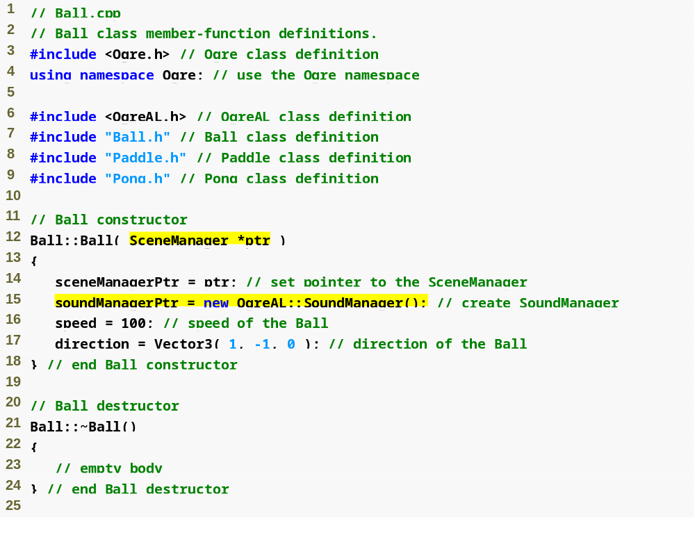
Outline
Ball.cpp
(1 of 7)
Create the SoundManager
Direction is determined by a Vector3

Slide 36
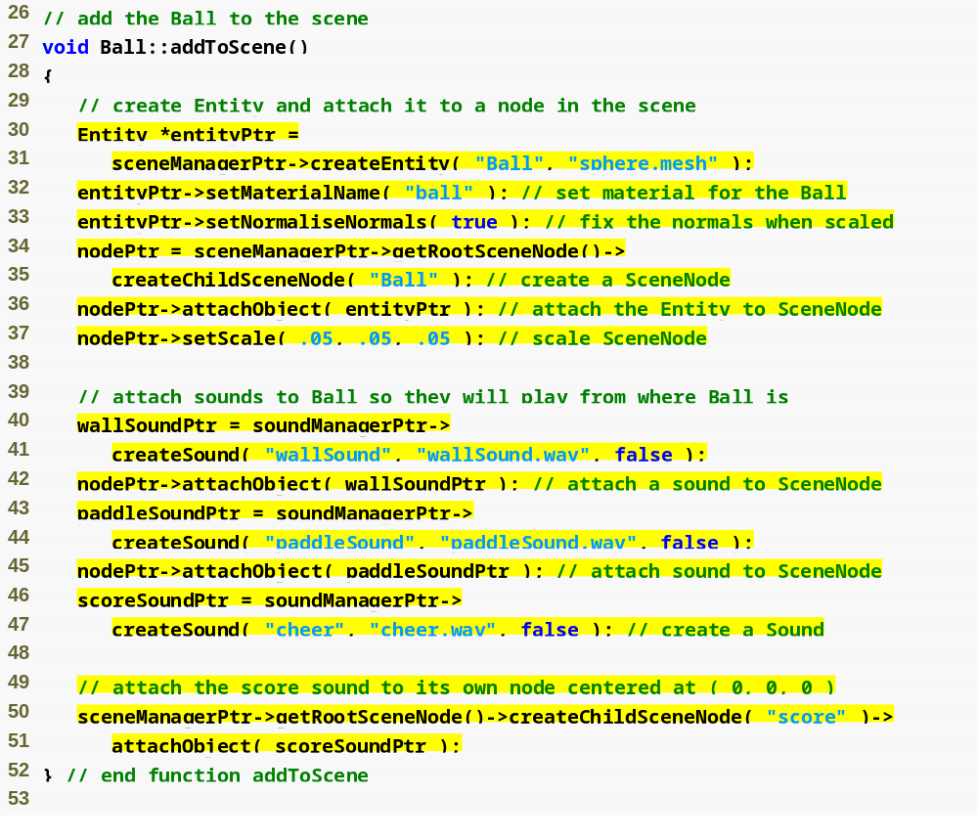
Outline
Ball.cpp
(2 of 7)
Use the sphere mesh to represent the Ball
Create a Sound object to be played
Add the Sound to the scene by attaching it to a SceneNode
The sound file to be played
Don’t loop the sound

Slide 37
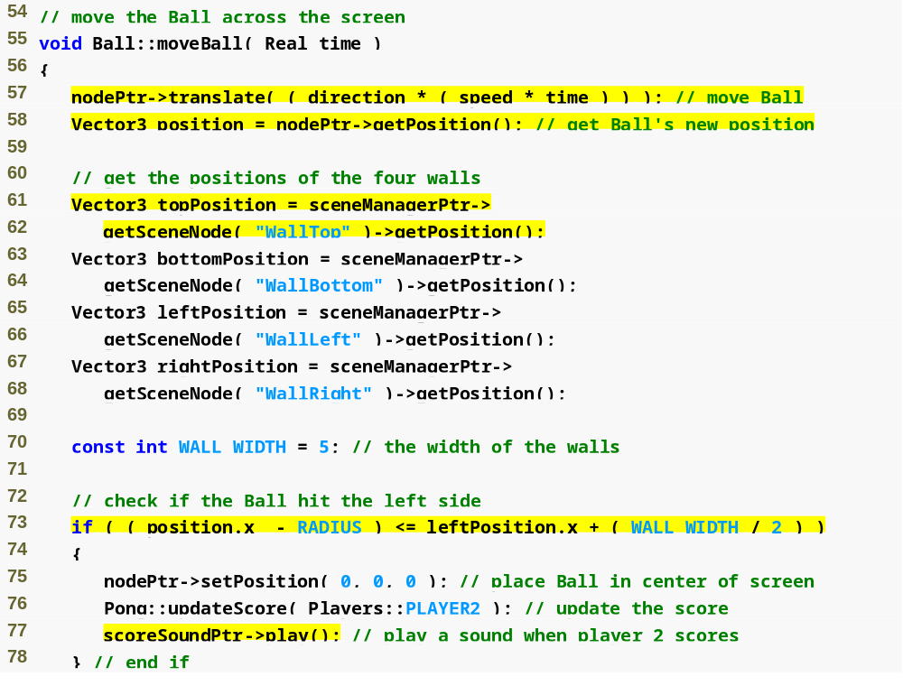
Move a SceneNode relative to its current position
Outline
Use the SceneManager to retrieve a SceneNode by name
Ball.cpp
(3 of 7)
Get the position of a SceneNode as a Vector3
If the Ball’s left side (x-coordinate minus radius) is less left wall’s right side (x-coordinate plus half the width), it hit the wall
Put the Ball in the middle of the screen
Give player 2 a point
Play the sound effect

Slide 38
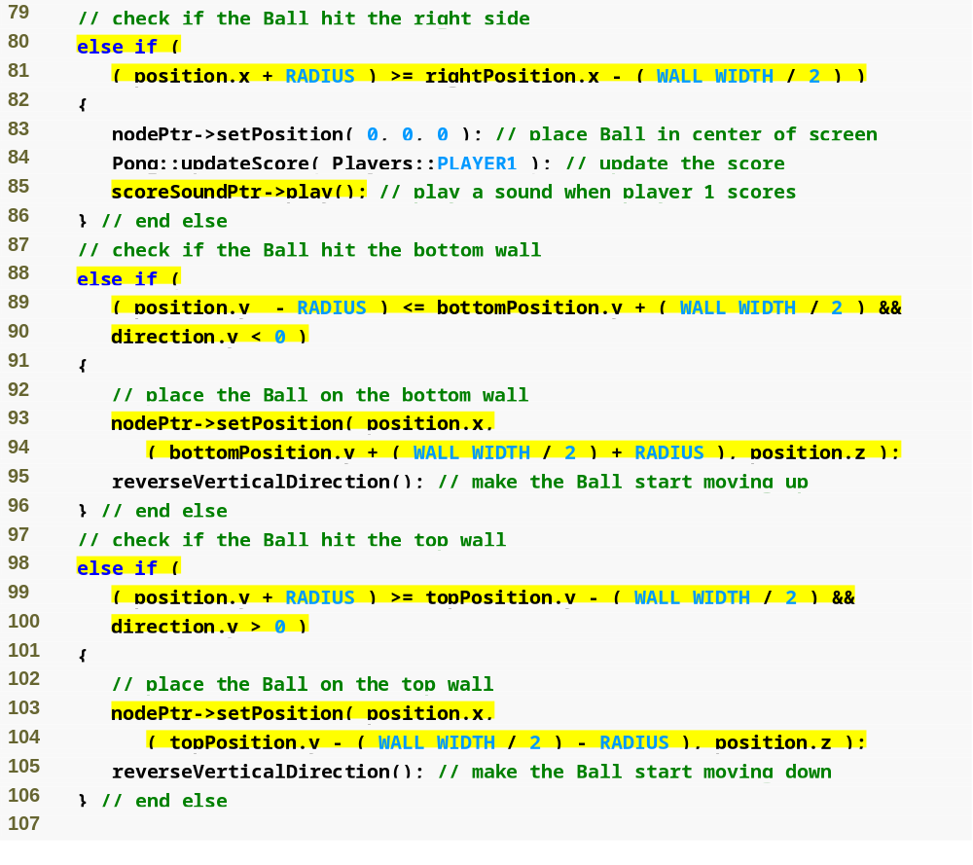
Outline
If the bottom of the Ball (y-coordinate minus radius) is less than the top of the bottom wall (y-coordinate plus half the width) it hit the wall
Ball.cpp
(4 of 7)
Place the Ball at the edge of the wall
Make the Ball start moving up

Slide 39
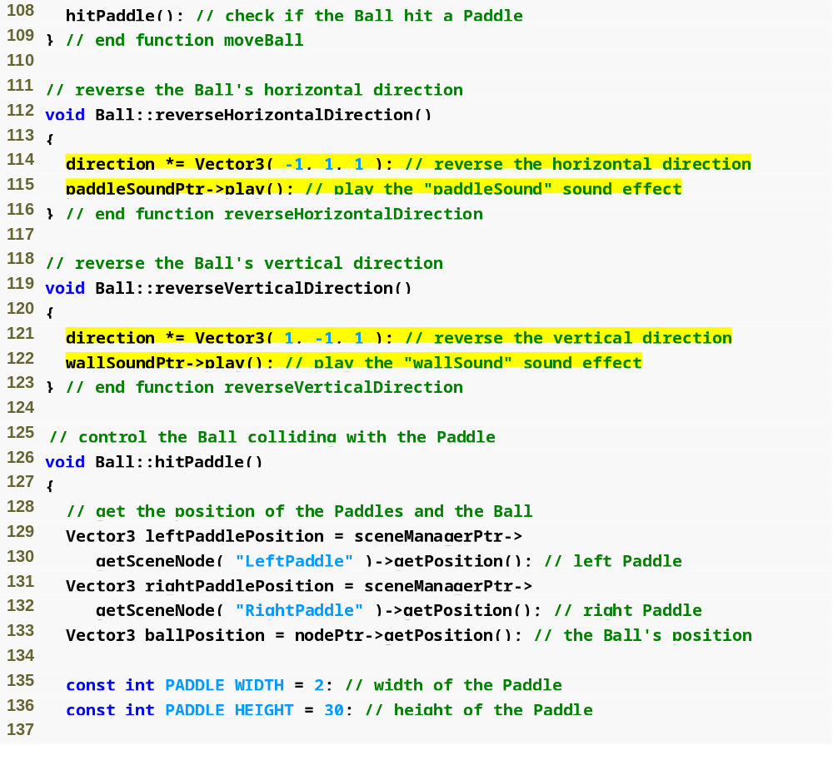
Outline
Change the sign of the x component in the vector
Ball.cpp
(5 of 7)
Play the appropriate sound effect
Change the sign of the y component in the vector
Play the appropriate sound effect
Get the positions of the Ball and Paddles
Dimensions of a Paddle

Slide 40
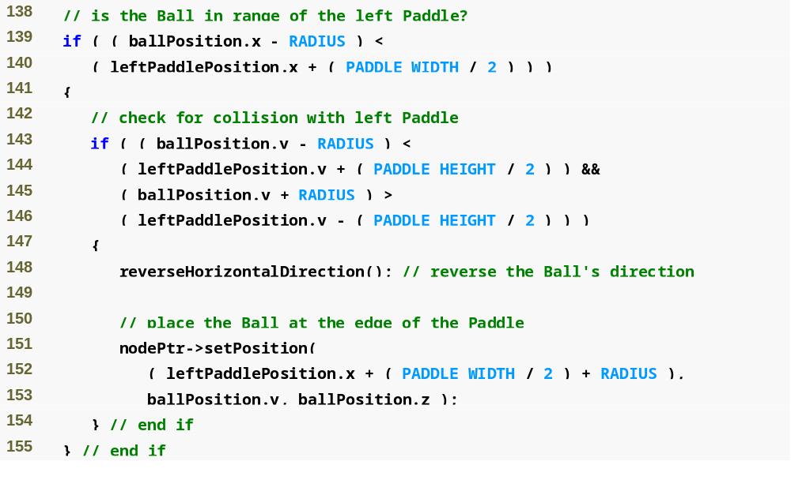
Outline
Check if the Ball is far enough left to hit the left Paddle
Ball.cpp
(6 of 7)
Check if the Ball’s y-coordinate is between the top and bottom of the Paddle
Change the direction of the Ball
Place the Ball at the edge of the Paddle

Slide 41
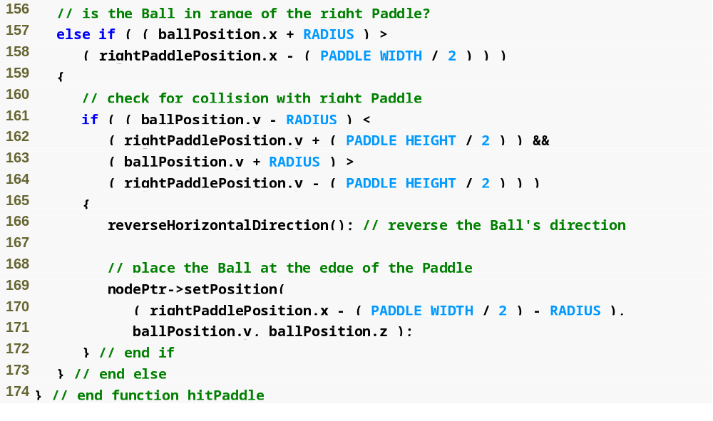
Outline
Ball.cpp
(7 of 7)

Slide 42
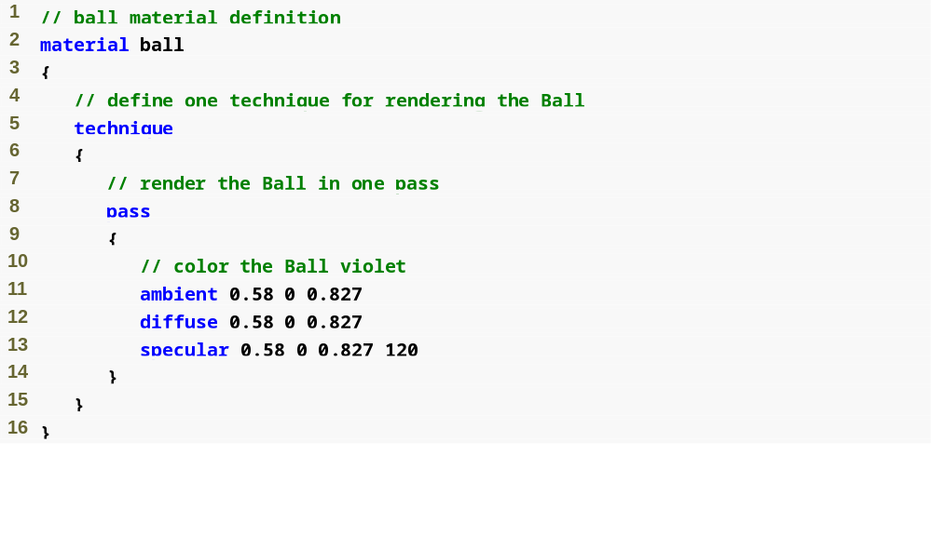
Name of the material
Outline
What color light the object reflects
How shiny the object is (any value greater than 0)

Slide 43
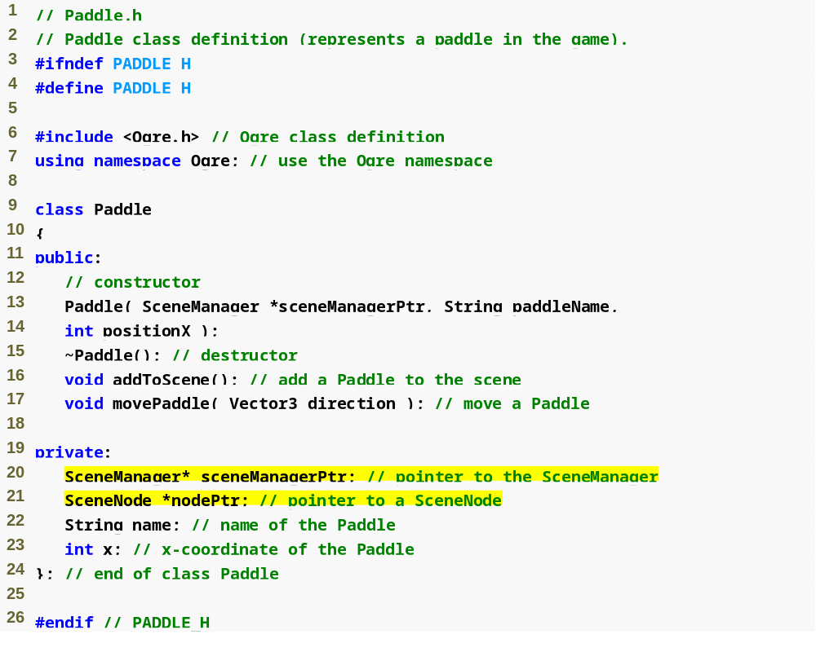
Outline
Paddle.h
Provide a name for the Paddle’s node to avoid name clashes
Where to place the Paddle
Move the Paddle in the given direction

Slide 44
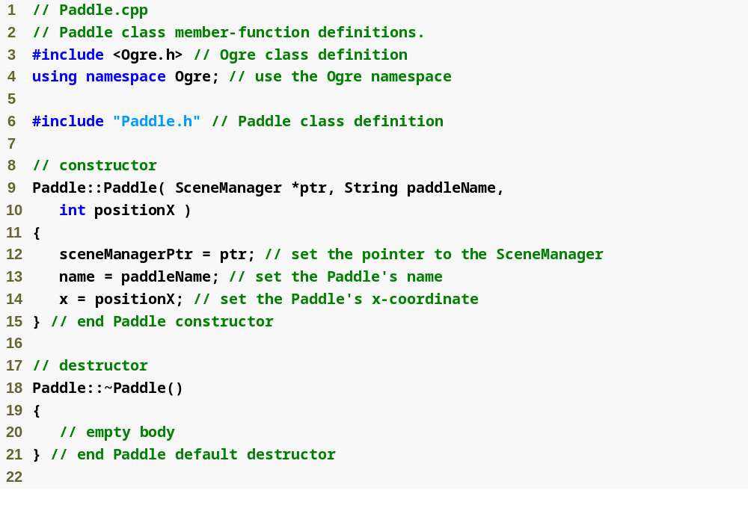
Outline
Paddle.cpp
(1 of 2)

Slide 45
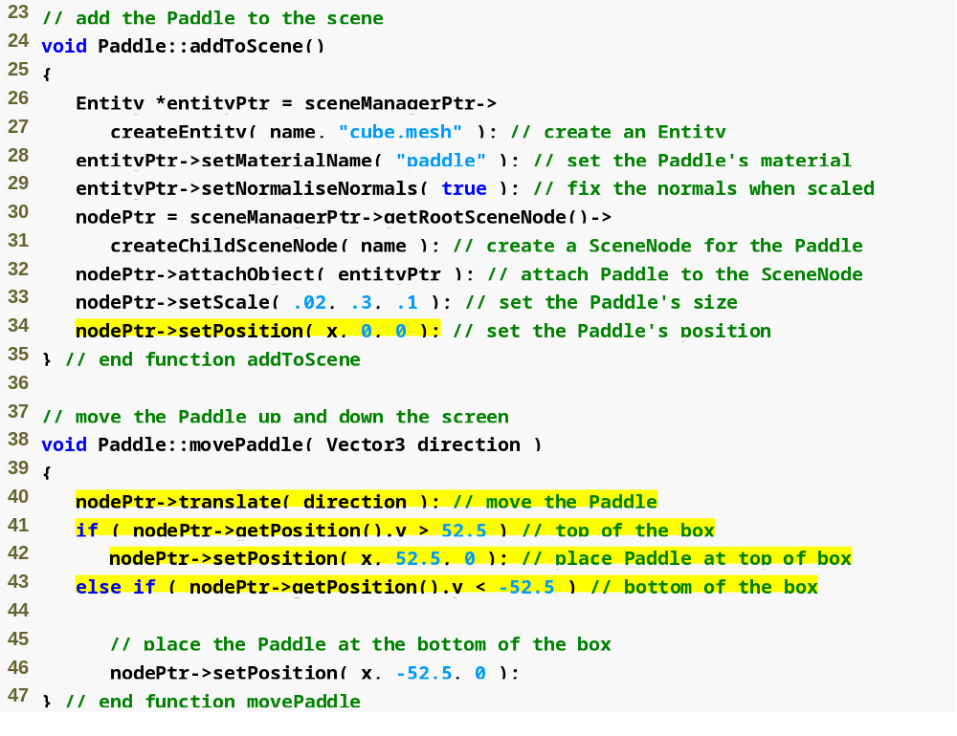
Outline
Paddle.cpp
(2 of 2)
Set the Paddle’s position
Move the Paddle in the given direction
Keep the Paddle from going out of the playing area

Slide 46
23.4.3 Adding to the Scene
Entity
  an instance of a mesh within the scene
  A mesh is a file that contains the geometry information of a 3D model
  Each Entity object must have a unique name

Slide 47
23.4.3 Adding to the Scene (Cont.)
A material is used to color an Entity
  Usually created with a script (text file with a .material extension), though it can be created directly in the program
  Structured similar to C++ code, with curly braces enclosing each section
  A material file can define multiple materials
  Each material defined must have a unique name

Slide 48
23.4.3 Adding to the Scene (Cont.)
SceneNode
  Encapsulates an object within the scene graph
  Each must have a unique name
  May have many children but only one direct parent
  Positioned at parent’s origin by default

Slide 49
23.4.3 Adding to the Scene (Cont.)
Overlay
  Renders on top of the scene
  Usually defined with a script—a text file with a .overlay extension
  Composed of OverlayElements
    OverlayContainer may hold any OverlayElement
    TextAreaOverlayElement displays text
    First element must be an OverlayContainer
  Metrics mode
    Pixel mode—size and position declared in pixels
    Relative mode—size and position declared relative to size and position of parent OverlayContainer (ranges from 0 to 1)

Slide 50
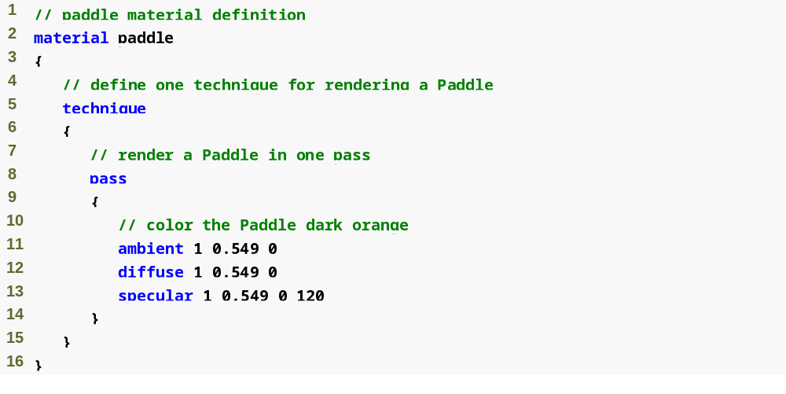
Create a material named paddle
Outline
What color light the object reflects
How shiny the object is (any value greater than 0)

Slide 51
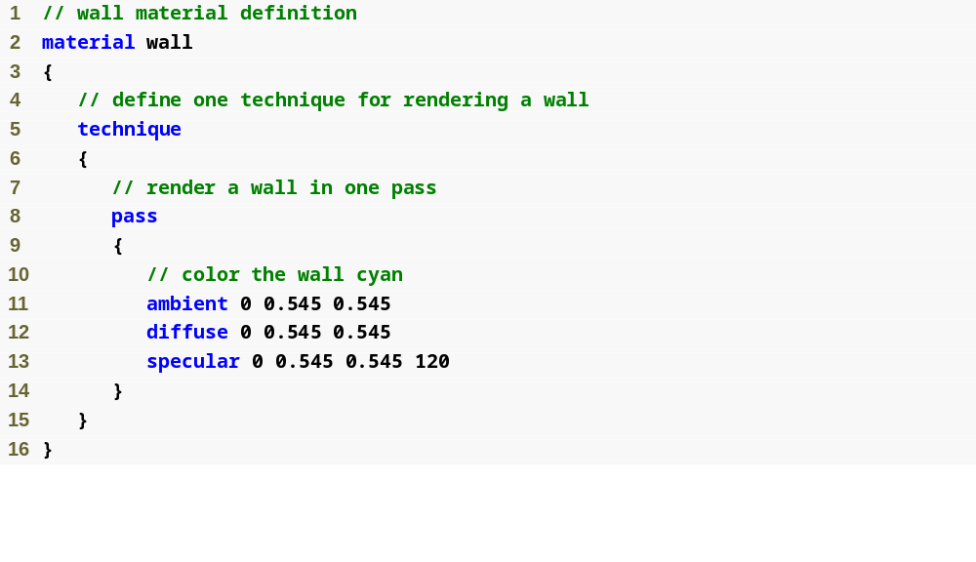
Create a material named wall
Outline
What color light the object reflects
How shiny the object is (any value greater than 0)

Slide 52
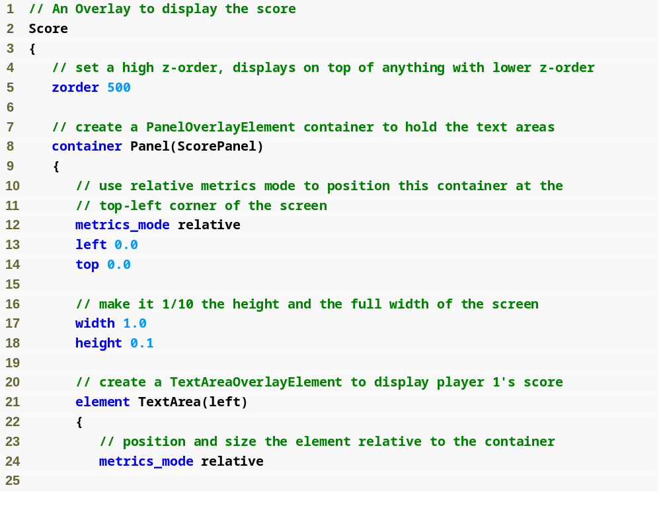
Create an Overlay named Score
Outline
A higher z-order renders on top of a lower z-order
Create a PanelOverlayElement
(a container) called ScorePanel
(1 of 3)
Size and position relative to parent (the window)
Place the top-left corner at (0, 0)
100% of the window’s width, 10% of the height
Create a TextAreaOverlayElement called left
Size and position relative to parent (the PanelOverlayElement)

Slide 53
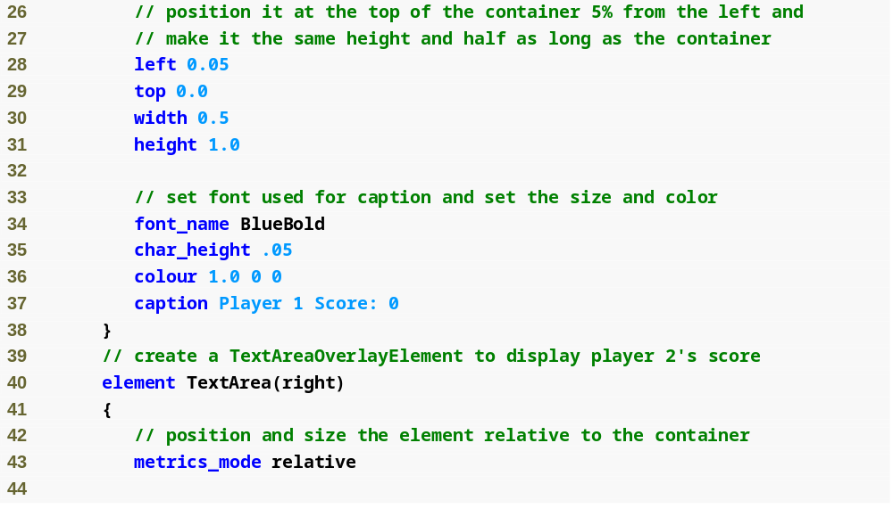
Outline
Position and size the TextAreaOverlayElement
(2 of 3)
Use the BlueBold font
Set the character height
Make the text red
The text to display

Slide 54
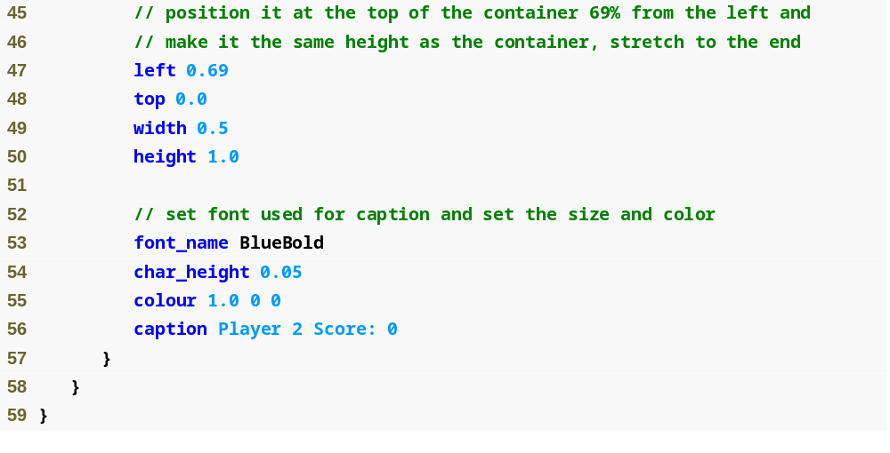
Outline
(3 of 3)

Slide 55
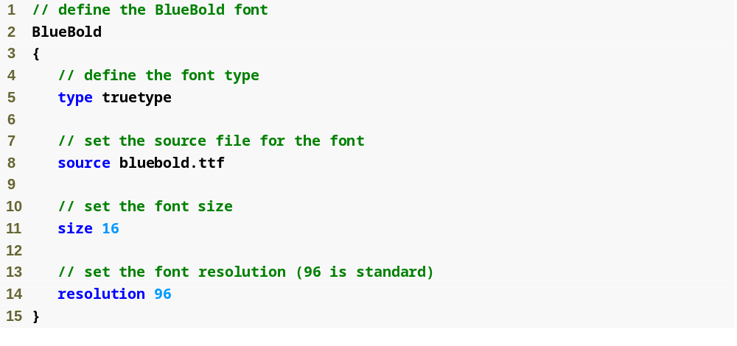
Create a font name BlueBold
Outline
This is a “true type” font
The font file
The font size (16 pt)
The font’s resolution

Slide 56
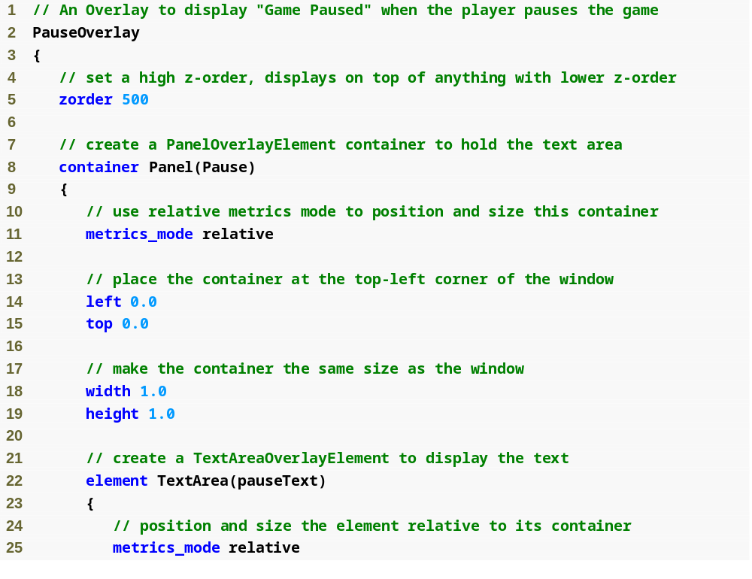
Outline
Create a PanelOverlayElement called Pause
(1 of 2)
Size and position it relative to its parent (the window)
Create a TextAreaOverlayElement called pauseText
Size and position it relative to its parent (the Pause container)

Slide 57
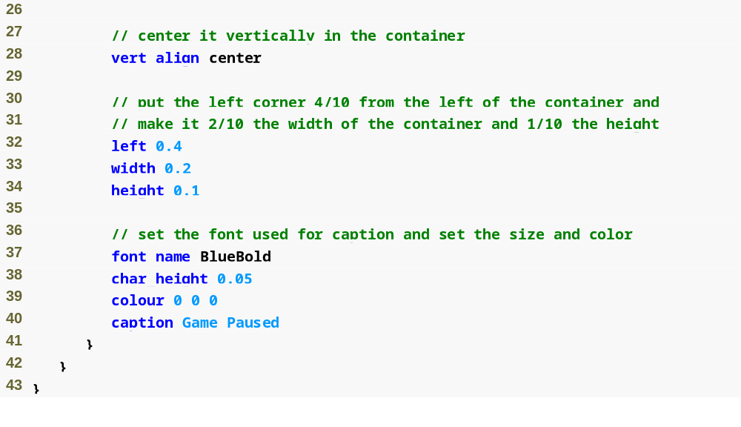
Outline
Vertically center the TextAreaOverlayElement in the container
Position the top-left corner 40% in from the left side of the parent container
(2 of 2)
Use the BlueBold font
Make the text black
The text to display

Slide 58
23.4.4 Animation and Timers
Moving a SceneNode
  translate function takes a Vector3—a three-dimensional vector type defined by Ogre
  Translations are done in parent space by default—translated with respect to its parent node’s position and orientation
  Translations in world space are done with respect to the origin of the scene (0, 0, 0)
  Translations in local space are done with respect to the node’s origin

Slide 59
23.4.4 Animation and Timers (Cont.)
The direction of the Ball is determined by a Vector3—each value represents a distance along the x-, y- or z-axis.
  Reverse a direction by changing the sign of the corresponding component in the vector

Slide 60
23.4.4 Animation and Timers (Cont.)
FrameListener
  Processes Ogre::FrameEvents.
  A FrameEvent occurs every time a frame begins or ends
  Every FrameListener has two functions—frameStarted and frameEnded
    Ogre keeps rendering frames until one of these functions returns false

Slide 61
23.4.5 User Input
Ogre does not directly support user input
The SDK includes Object Oriented Input System (OIS)
  The InputManager is used to create the various input devices.
  We create a Keyboard object which represents the actual keyboard.
  A KeyListener responds to input from the keyboard
    KeyEvents are indications that the player has hit a key

Slide 62
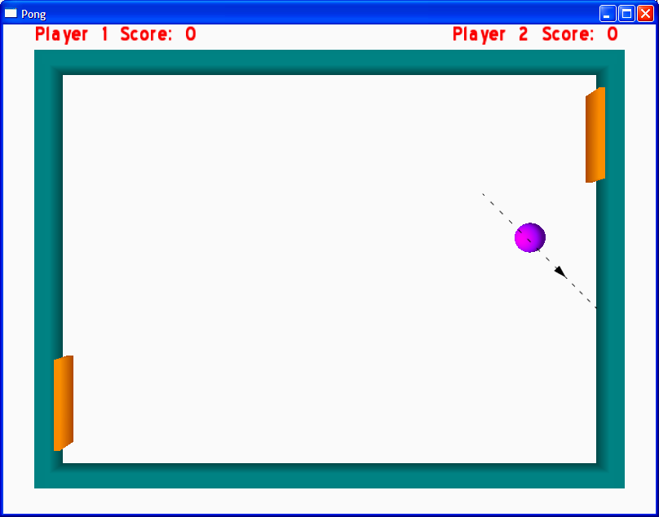
Fig. 23.17 | Player 1 scoring a point. (Part 1 of 3.)

Slide 63
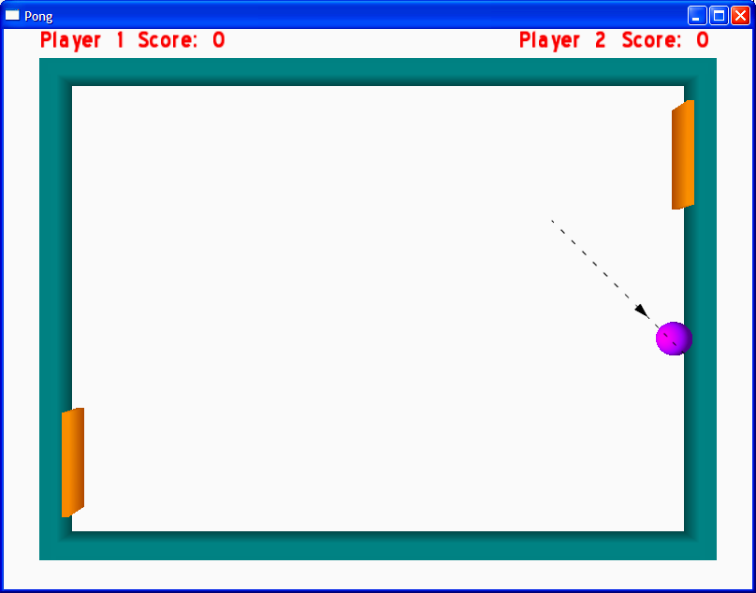
Fig. 23.17 | Player 1 scoring a point. (Part 2 of 3.)

Slide 64
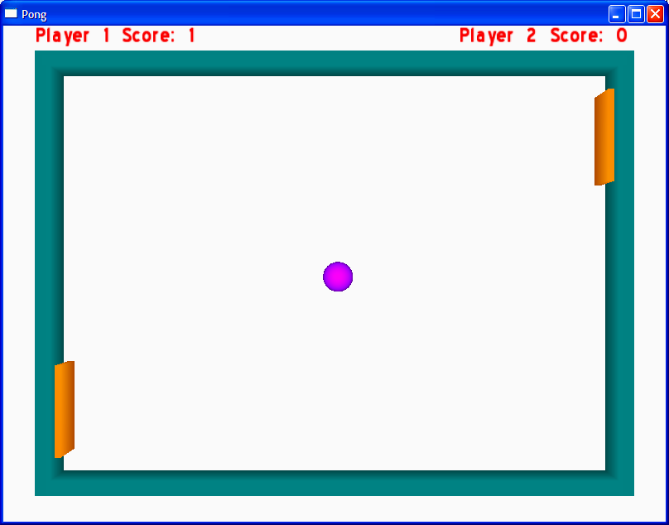
Fig. 23.17 | Player 1 scoring a point. (Part 3 of 3.)

Slide 65
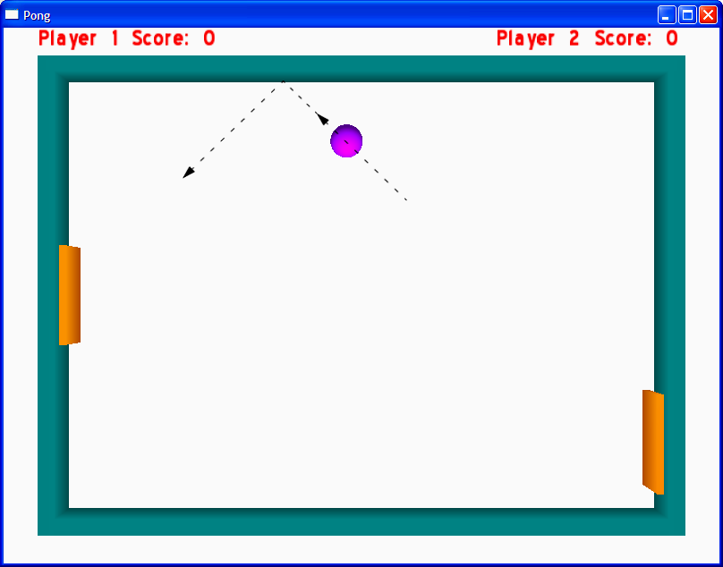
Fig. 23.18 | The Ball bouncing off the top wall. (Part 1 of 3.)

Slide 66
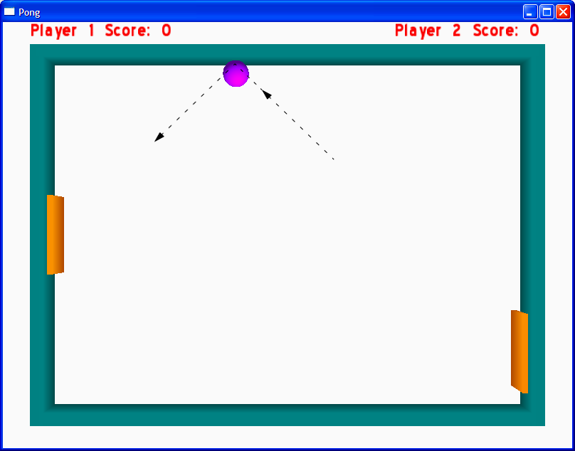
Fig. 23.18 | The Ball bouncing off the top wall. (Part 2 of 3.)

Slide 67
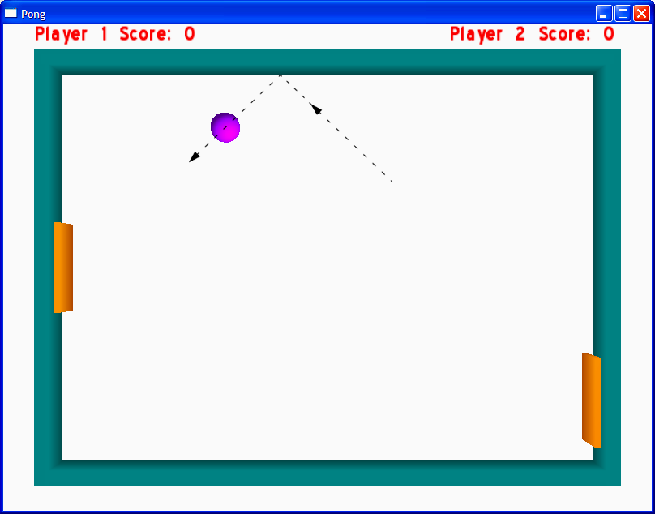
Fig. 23.18 | The Ball bouncing off the top wall. (Part 3 of 3.)

Slide 68
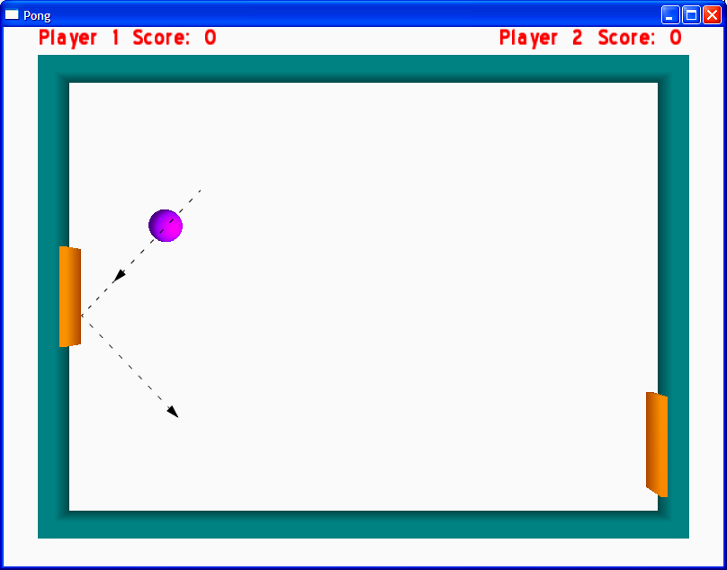
Fig. 23.19 | The Ball bouncing off the left Paddle. (Part 1 of 3.)

Slide 69
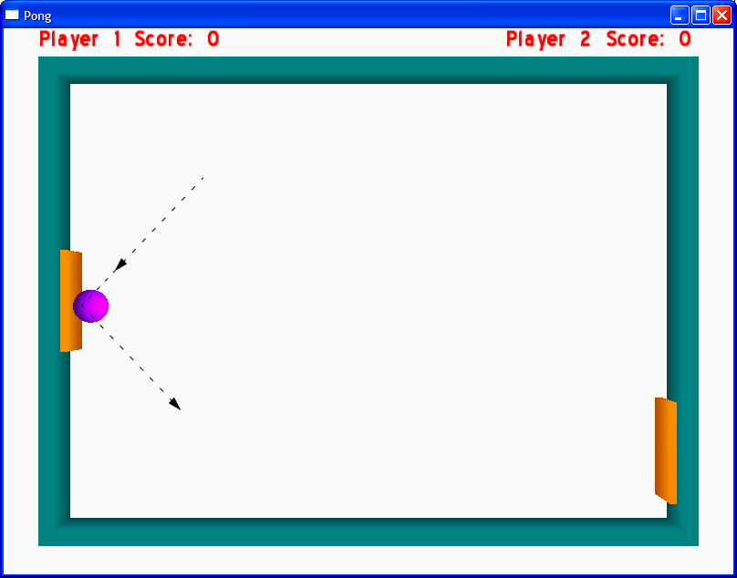
Fig. 23.19 | The Ball bouncing off the left Paddle. (Part 2 of 3.)

Slide 70
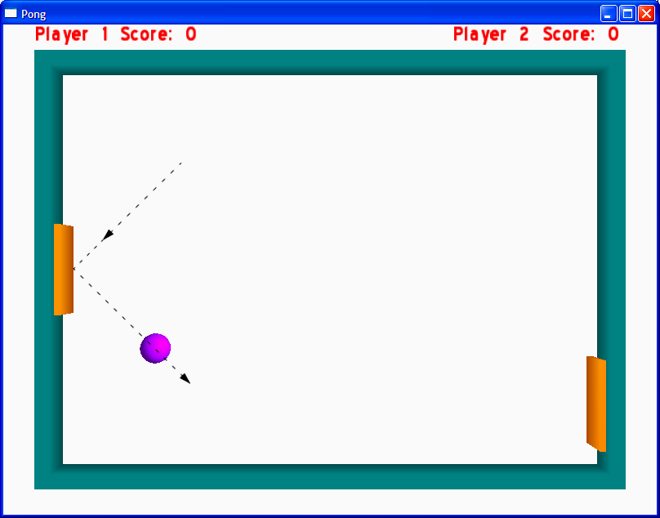
Fig. 23.19 | The Ball bouncing off the left Paddle. (Part 3 of 3.)

Slide 71
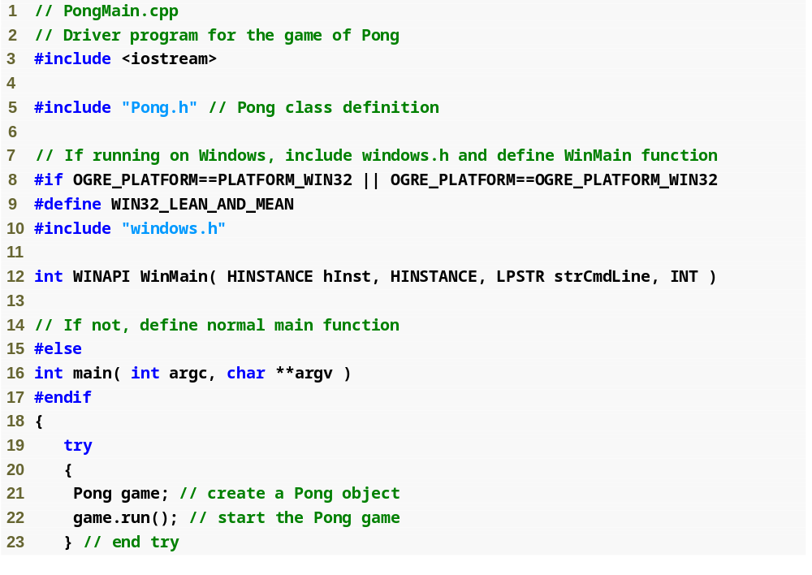
Outline
PongMain.cpp
(1 of 2)
Include the necessary Windows headers and define the WinMain function
Check if the program is running on the Windows platform
Define a normal main function if not running on Windows platform
Create the Pong object—will throw an exception if user cancels the settings dialog box
Start running a game of Pong

Slide 72

Outline
Catch a runtime_error thrown by the Pong constructor
PongMain.cpp
(2 of 2)
If running on Windows, display the error message is a pop-up dialog box
If not running on Windows, use the standard error stream

Slide 73
23.4.5 Collision Detection
There are Ogre binding for several collision and physics libraries
  Open Dynamics Engine (ODE, www.ode.org/)
  Bullet (www.continuousphysics.com/Bullet/)
  Newton Game Dynamics (www.newtondynamics.com/)
  PhysX (www.ageia.com)

Slide 74
23.4.5 Sound
Ogre does not support sound
OgreAL
  Wrapper around the OpenAL audio library
  Used to integrate sound functionality into Ogre code
  SoundManager class used to manage OgreAL objects
    There can be only one SoundManager
  Sound objects contain the sound data
  Attach Sounds to SceneNodes
  Each Sound must have a unique name
  A Sound must finish playing before it can be played again

Slide 75
23.4.5 Resources
Ogre programs use various external resources
  Scripts to create Materials and Overlays
  .mesh files to represent 3D objects
  OgreAL uses sound files
ResourceGroupManager
  Manages a programs resources
Ogre will throw a runtime exception if you try to use a resource that hasn’t been loaded

